Slide 1
3D-Pacman CSL781 Final Project
Abhishek Kumar (2011CS50272) & Nikhil Verma(2011CS50287)

Slide 2
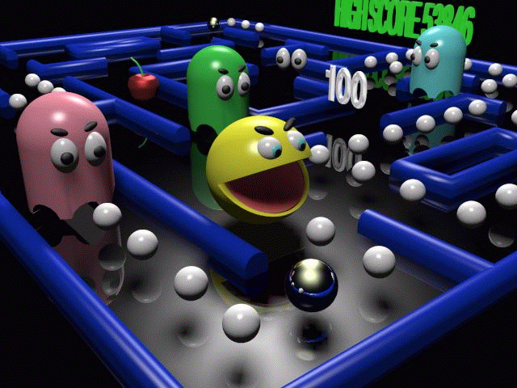
Motivation

Slide 3
Demo

Slide 4
Highlights
Camera Movement- various camera modes for perfect views
Maze- maze design, input format and rendering
Pacman- model and movement
Ghosts- model
Rotation Animation
Collision Detection
Used Multi-Threading for performance
Environment Mapping

